Slide 1
2021 ACLS Review
(941) 363-1392 www.CMRCPR.com | FL

Slide 2
DISCLAIMER
The following information is provided by the American Heart Association.
This is a study guide to give providers a sense of what to focus their studies on.
Please review and study your American Heart Association ACLS Manual before attempting to complete the AHA ACLS Course.

Slide 3
Assessment
Responsive: (ABC’s) Airway, Breathing, Circulation
Unresponsive: (CAB) Circulation, Airway, Breathing.
*Remember the basics: BLS before ACLS

Slide 4
Basic Life Support
Responsiveness
Pulse/Breathing within 10 seconds
Agonal Respirations =Cardiac Arrest
Chest Compressions
Ratio
Rate
Depth
Recoil?

Slide 5
Coronary Perfusion Pressure

Slide 6
Optimizing Perfusion Assessment with Capnography
Rapidly and accurately alert providers to perfusion and or metabolic problems
ETCO2 > BP more crucial to specifically assessing perfusion status
ETCO2 greater than or equal to 10
Optimal tool used to ensure high quality CPR.

Slide 7
Basic Life Support
Use the AED/manual defibrillator as soon as it arrives
What if AED does not give commands?
ROSC with continuous compressions while the AED is charging or pre charge monitors.
Reassessment every 2 minutes or 5-7 cycles.

Slide 8
Basic Life Support
Ventilation
Maintain SAO2 of 94% or >
Progression of the Airway!
OPA vs NPA
BVM (2 rescuer only)
BVM rate (1 breath every 5-6s = 10-12 bpm)
Complications of excessive ventilations?

Slide 9
Advanced Life Support
Please remember to think BLS before ALS!
Unresponsive, pulseless, apneic?
Unresponsive, pulses, apneic?
Unresponsive, pulses, breathing?
AMS, pulses, breathing?
ETC……………..
Know causes (H and T’s )

Slide 10
Advanced Life Support
Stable vs Unstable
Stable:
A/Ox4
No CP/SOB
Normal PMS
Systolic BP of 90 or >
Skin warm/dry/normal color

Slide 11
Advanced Life Support
Stable vs Unstable
Unstable:
Lethargic or AMS
Significant CP and SOB (<94% SAO2)
Weak and Thready Pulses
Systolic BP of < 90
Skin cool/diaphoretic/pale color

Slide 12
Advanced Life Support
Ventilation
Maintain SAO2 of 94% or >
Advanced Airways
Types (IE: ET tube)
Ventilations- 1 breath every 6 seconds = 10 bpm during arrest and normal BLS rate during RSI.
Continuous compressions during arrest

Slide 13
Advanced Life Support
Ventilation
Normal ETCO2 of 35-45
Typically lower (10-20) during cardiac arrest.
ETCO2 less than 10 is a sign of poor perfusion and decreased CPP.
ETCO2 of “0” is a failed intubation
Exhaled CO2
Spikes in ETCO2?

Slide 14
Normal Capnography

Slide 15
Bronchospasm

Slide 16
Advanced Life Support

Slide 17
Advanced Life Support
Acute Coronary Syndrome
12-lead priority
90 Minutes is the max goal time for first medical contact to balloon inflation time.
MONA:
Morphine- 2-4mg
Oxygen-as needed
Nitro- 0.4mg
Aspirin- 162-325mg
*Contraindications of giving Nitro?
*Identification of Posterior MI?

Slide 18
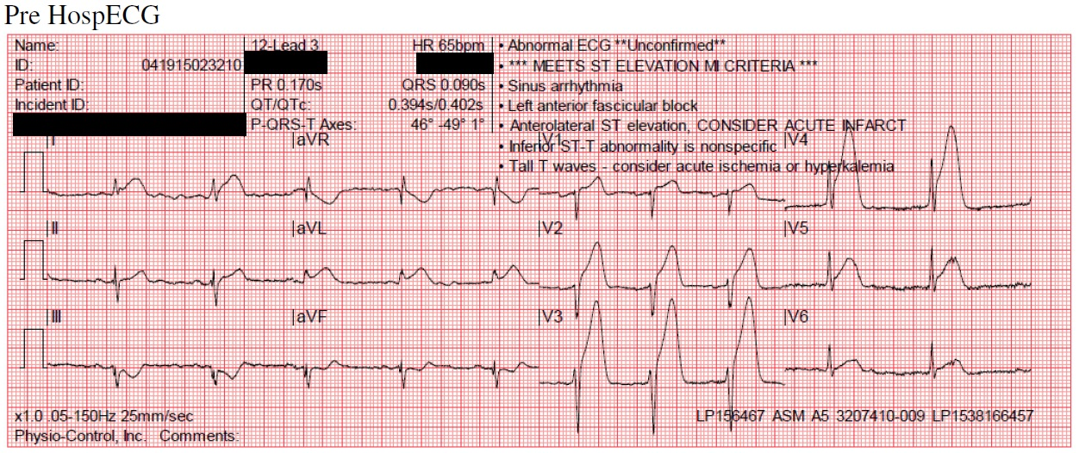
Advanced Life Support
Acute Coronary Syndrome
Anterior STEMI (V1-V6)

Slide 19
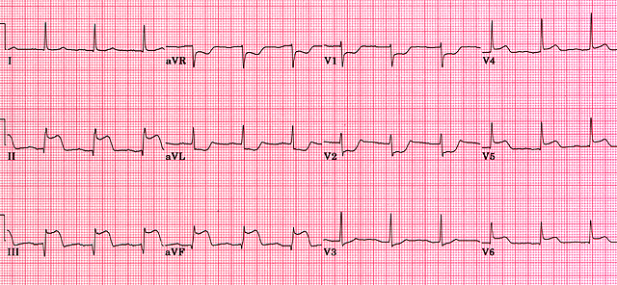
Advanced Life Support
Acute Coronary Syndrome
Inferior STEMI (II, III, AVF)

Slide 20
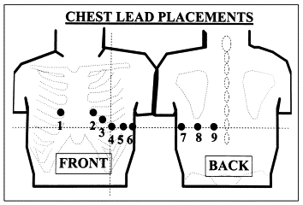
Advanced Life Support
15-Lead EKG
-15 LEAD EKG PLACEMENT

Slide 21
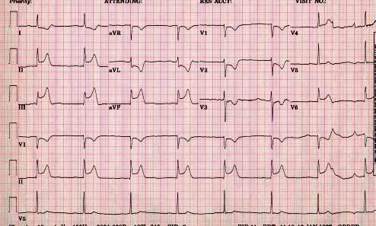
Advanced Life Support
Acute Coronary Syndrome
Posterior MI (Reciprocal changes in V1-V3 with ST-Elevation in II, III, AVF)

Slide 22
Advanced Life Support
Acute Stroke
Time is of the essence (3-5 hours)
Hemorrhagic or Ischemic?
Tpa vs Surgery?
CT Scan
Components of Cincinnati STROKE assessment
Always think BLS and get a blood Glucose first!

Slide 23
Advanced Life Support
Pefusing Rhythms:
Normal Sinus Rhythm
Sinus Brady
Heart Blocks
Sinus Tach
SVT
V-Tach
A-Fib

Slide 24
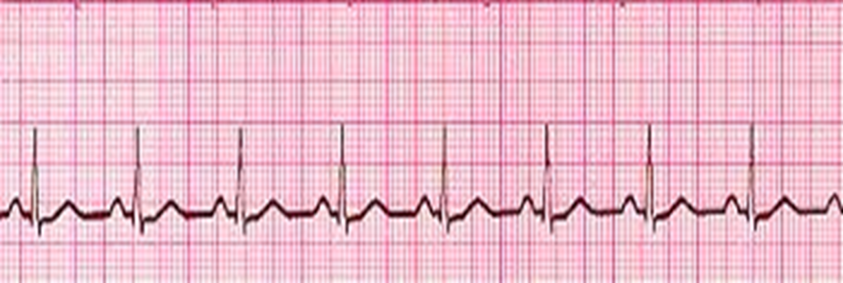
Normal Sinus Rhythm

Slide 25
Sinus Bradycardia

Slide 26
Sinus Bradycardia
-Heart rate typically <50/min
-Only treatable if showing signs of poor perfusion
-Treatment:
-Perfusing: Oxygen and Fluids
-Poor Perfusion:
1. Atropine- 1 mg every 3-5 min (Max of 3mg)
Derived from the Nightshade Plant (deadly)
Dilates pupils, increases heart rate
Used to treat symptomatic bradycardia only

Slide 27
Sinus Bradycardia
2. Dopamine- 2-20mcg/kg/min
-Second-line drug for symptomatic bradycardia when atropine is not effective
-Used for cardiogenic shock in the absence of hypovolemia
3. Epinepherine- 0.1-0.5 mcg/kg/min infusion.

Slide 29
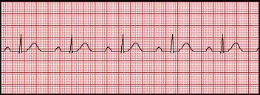
1st Degree Heart Block
Not treatable in ACLS unless symptomatic
PRI- >0.20 (5 small boxes)
If the Rs are far from Ps, then you have a 1st Degree
I.E. Distance yourself from your partner, but stay together!
If symptomatic, treat with same medications as bradycardia.

Slide 30
2nd Degree Heart Block, type 1 aka “Wenckebach”
Not treatable in ACLS unless symptomatic
PRI- Long, long, longer, DROP- must be a Wenckebach!
I.E. Steadily Drift apart until you break up!
If symptomatic, treat with same medications as bradycardia.

Slide 31
2nd Degree, Type 2 Heart Block
Blocked P waves/dropped QRS Complexes
If some Ps don’t have Qs, then you have a Mobitz 2
I.E. On again, off again relationship!
This is getting worse…
Always get a 12-lead?
Treatment:
No Atropine!
Pacing

Slide 32
3rd Degree Heart Block (Complete Heart Block)
Usually Bradycardic, Irregular
Won’t take long…NEED TO TREAT!
If the Ps and Qs do not agree, then you have a 3rd degree!
Complete breakdown of the relationship!
Treatment:
No Atropine
Pacing

Slide 33
Cardiac Pacing
Set pacer to 60-80 bpm
Slowly increase mA until electrical capture
Confirm mechanical capture via SPO2 Pleth waveform.

Slide 34
Sinus Tachycardia
HR: 101-149

Slide 35
Supra Ventricular Tachycardia (SVT)

Slide 36
Supra Ventricular Tachycardia (SVT)
Firing somewhere above the Ventricles
Treatable when sustained HR of 150 or > BPM per ACLS
Regular and FAST!
If stable perform 12-lead! Use Valsalva Maneuver First (Think BLS)
Stable= Drugs. Adenosine 6mg, 12mg, done.
Inhibits neurotransmitters
“Resets” heart
Asystole for 3-5 seconds
Causes a transient heart block in the AV node

Slide 37
Supra Ventricular Tachycardia (SVT)
Unstable= Electricity. Synchronized Cardioversion. (sedate first) 100 J,200J, 300J 360J* (discussed in class)
MAKE SURE YOU PUSH SYNCH BUTTON!

Slide 38
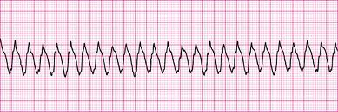
Ventricular Tachycardia With Pulses

Slide 39
Ventricular Tachycardia With Pulses
Extremely dangerous arrhythmia
Patient wont last long
12-lead if stable
Wide and Bizarre pattern and regular

Slide 40
Ventricular Tachycardia With Pulses
Treatment:
-Valsalva maneuver first (Think BLS)
Stable
Use Amiodorone
Anti-arrhythmic
Works on the Atria and the Ventricles
150 mg bolus over 10min, repeat X1.
1 mg/min maintenance drip if you break rhythm

Slide 41
Ventricular Tachycardia With Pulses
Stable
Use Lidocaine
Anti-arrhythmic
Works on the Atria and the Ventricles
1-1.5 mg/kg bolus over 10min, repeat 0.5-0.75 mg/kg with max of 3mg/kg.
1-4 mg/min maintenance drip if you break rhythm

Slide 42
Ventricular Tachycardia With Pulses
Unstable
Electricity (Monophasic) aka synchronized cardioversion.
100J,200J, 300J 360J
Try to sedate first. Don’t delay treatment.

Slide 43
Atrial Fibrillation

Slide 44
Atrial Fibrillation
-Irregularly irregular
-Typically benign and patient’s can live out a normal life with rate controlling medications and anticoagulants.
-Typically presents as palpitations
-Only treat if sustained HR of 150 or >

Slide 45
Atrial Fibrillation
Valsalva maneuver first (Think BLS)
Treatment:
Stable
-Diltiazem (0.25mg/kg slow IV push over 2 min)
-May repeat x1 at 0.35 mg/k
Unstable
-Synchronized Cardioversion
-Use extreme caution?
- Recommended dose = 120-200J

Slide 46
Cardiac Arrest
*Think BLS before ACLS
-Early CPR and Defibrillation
-Use a systematic Approach to integrate ALS Skills and medications.
-Can be categorized into two groups: Shockable and Non-Shockable.
-Shockable: V-Fib and V-Tach w/o pulses
-Non-Shockable: PEA and Asystole

Slide 47
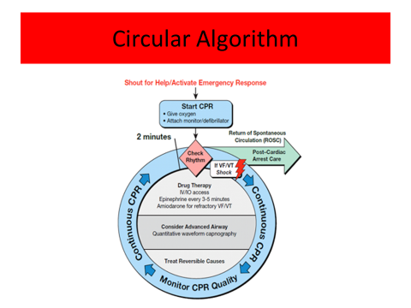

Slide 48
Ventricular Fibrillation (V-Fib)

Slide 49
Ventricular Fibrillation (V-Fib)
Won’t have a pulse
Fine or coarse
Shock-able rhythm
Start at 360J, and continue at 360J* (With a MONO-phasic Defibrillator)
High Quality CPR

Slide 50
Ventricular Fibrillation (V-Fib)
Epinephrine- 1mg every 3-5 minutes (no MAX)
Hormone naturally occurring in the body
Affects the Sympathetic Nervous System
Constricts blood vessels, increases peripheral resistance
Increases Heart Rate (Inotropic effects and Chronotropic effects) (contractility and rate)
Amiodarone- 300mg, then 150mg (450mg MAX)

Slide 51
Ventricular Fibrillation (V-Fib)
Lidocaine- Initial dose of 1-1.5 mg/kg
Additional dose of 0.5-0.75 mg/kg
Max of 3 doses or total of 3mg/kg

Slide 52
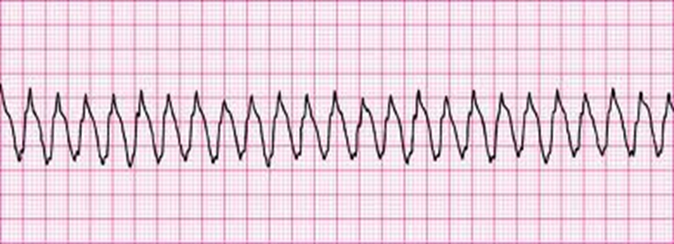
Ventricular Tachycardia w/o pulses

Slide 53
Ventricular Tachycardia w/o Pulses
Fine or coarse
Shock-able rhythm
Start at 360J, and continue at 360J* (With a MONO-phasic Defibrillator)
High Quality CPR
Epinephrine- 1mg every 3-5 minutes (no MAX)
Amiodarone- 300mg, then 150mg (450mg MAX) or Lidocaine- 1-1.5 mg/kg, then 0.5-0.75 mg/kg.

Slide 54
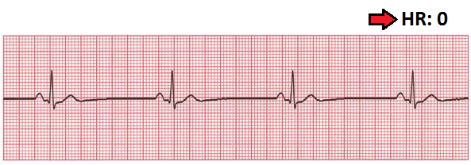
Pulseless Electrical Activity

Slide 55
Pulseless Electrical Activity
Organized rhythm without a pulse.
Typically resembles Normal Sinus in origin.
NON- SHOCKABLE!
Remember H and T’s
High quality CPR
Epinephrine, 1.0 mg
Push Epi Always

Slide 56
Asystole (Flat line)

Slide 57
Asystole (Flat line)
Heart not producing ANY electrical activity
NON-Shockable Rhythm
Patient is DEAD
Treatment:
High quality CPR
Epinephrine- 1.0mg (no max)

Slide 58
H’s and T’s
Hypovolemia
Hypoxia
Hydrogen Ions (acidosis)
Hyper/Hypo kalemia
Hypothermia
Toxins
Tamponade (cardiac)
Tension Pneumothorax
Thrombosis (coronary)
Thrombosis (Pulmonary)

Slide 59
ROSC: Post Cardiac Arrest
Optimize ventilation and oxygenation
Treat Hypotension
12-lead
Labs
Initiate hypothermia management
1-2L of cold normal saline
Temp of 32-36 C over 24 hours

Slide 60
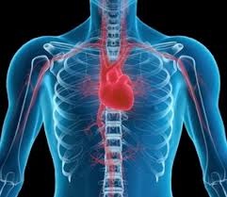
THE END!
THANK YOU!!!

